Slide 1
Assembly 1: Introduction to empathy

Slide 2
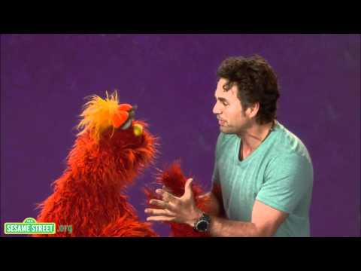
What is empathy?
https://www.youtube.com/watch?v=9_1Rt1R4xbM

Slide 3
There are three parts to empathy
Experiencing for yourself how other people are feeling
Working out why people are thinking and feeling the way they are
Doing something about what we have discovered

Slide 4
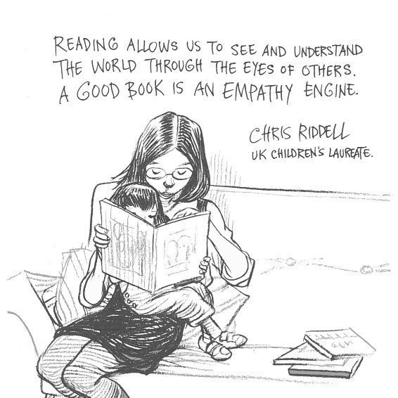
Stories!

Slide 5
Stories!

Slide 7
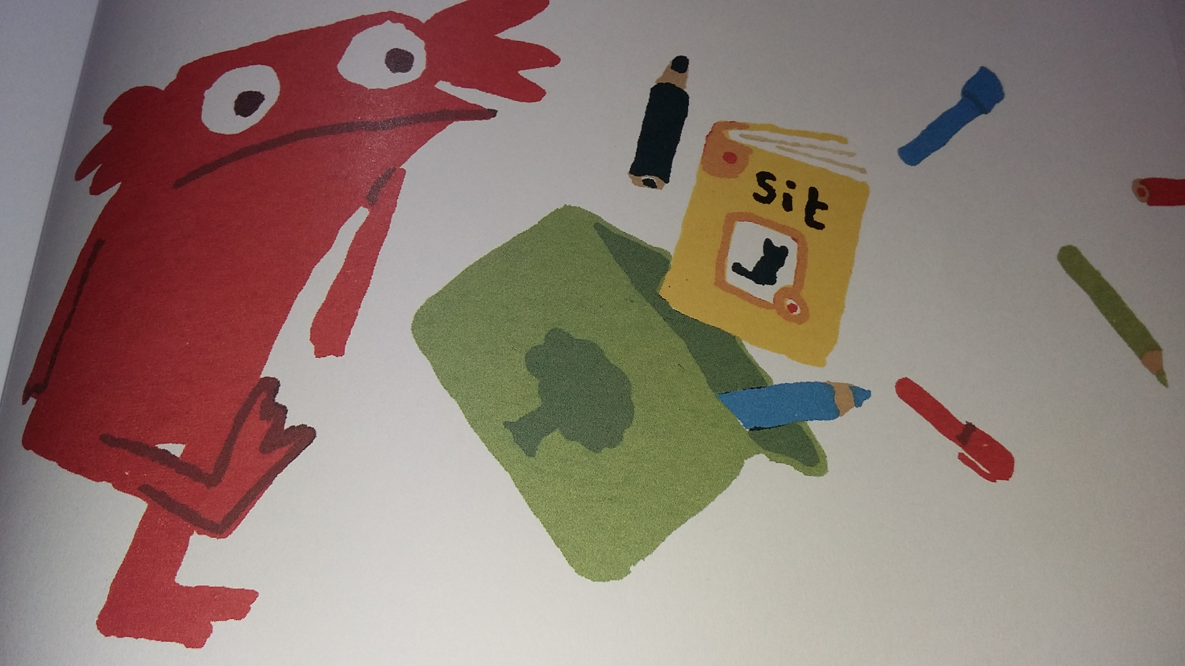
I do not like books anymore!
Show image of this page.

Slide 8
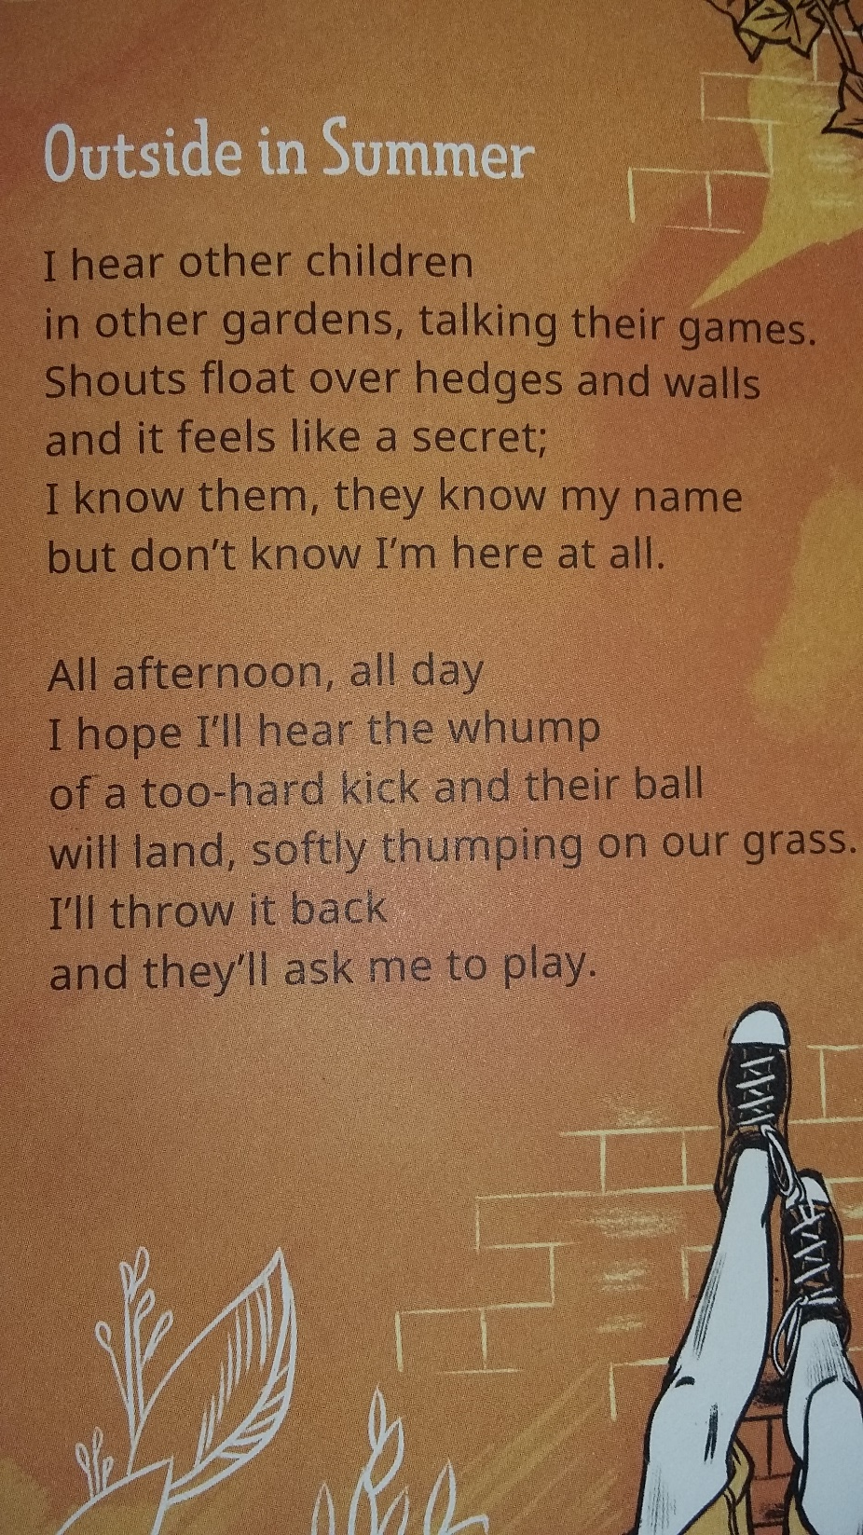

Slide 9
Assembly 2: Perspective-taking

Slide 10
Insert picture of previous assembly gathering (rotated 180 degrees) – see script

Slide 11
What do you see?

Slide 13
Assembly 3: From empathy into action

Slide 15
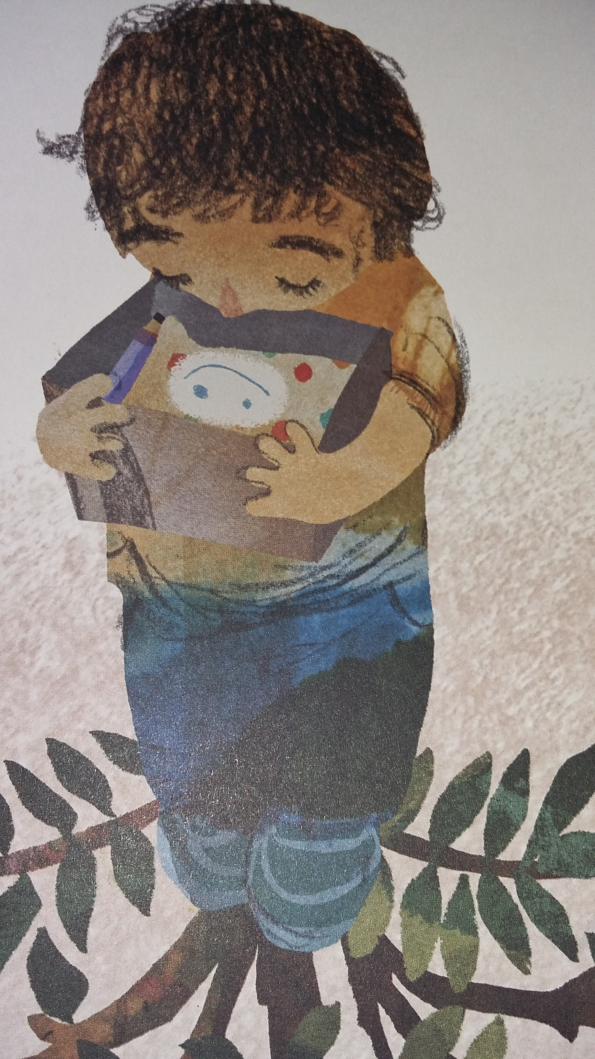

Slide 16
Assembly 4: Empathy Day

Slide 18
Empathy Day 9 June 2020
Empathy Day is all about focusing on empathy and helping us understand each other better.
It is also a day to:
Celebrate the empathy-building steps we’ve taken so far
Plan the next steps on our empathy journey

Slide 19
Add examples of children’s work

Slide 20
On Empathy Day (and beyond) we want everyone to…
Read: because stories and book characters build our real-life empathy
Connect: practice listening 100% to make new connections with people
Act: put empathy into action, in your home and your community
Notes:
Depending on the amount of work your school has done on social action, you may need to elaborate a bit further on the ‘doing’ part – how can you make a difference, what can you actually do? How is this part of the empathy skill?

Slide 21
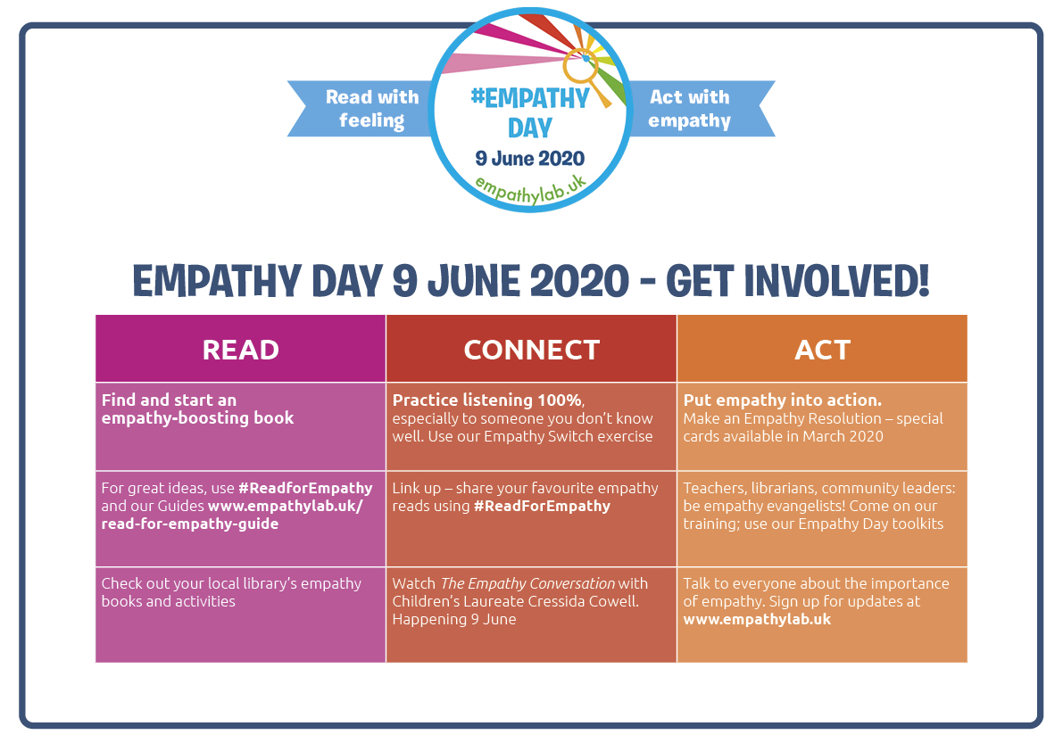

Slide 22
What we will be doing
Read It builds real life empathy | Connect Practice listening 100% | Act Put empathy into action
Notes:
Share the activities that will be taking place on Empathy Day (AND beyond as appropriate) across the school/ in different classes (these might be organised into the three categories of Read, Connect, Do if appropriate or in another format of your choosing).
You could share examples of activities taking place in other schools on Empathy Day to create a sense of solidarity/ shared activity; you could even buddy with one other school in particular and video link with them

